Slide 1
⚖
THE JUDGE
Bias & Fairness in AI — Predicting Income with the Adult Census Dataset
Group Members
Adewusi Adam
Enang Rapheal
Data Science with Python — End-to-End Final Project

Slide 2
THE PROBLEM
Why Fairness in AI Matters
AI models are increasingly used to make decisions that affect people's lives — loan approvals, hiring, insurance pricing, and credit scoring. When these models learn from historical data, they can absorb and repeat existing social inequalities, even when built with good intentions.
3x
Gap in real-world high-income rate between men and women in our dataset
48.8%
A common but flawed assumption is that removing a sensitive attribute (like race or sex) from a model's training data automatically makes it fair. This project tests that assumption directly.
False Negative Rate for Black individuals — our model's biggest error gap

Slide 3
PART B — STEP 1
The Dataset
Adult Census Income
32,561
Sourced from Kaggle (UCI Machine Learning Repository). Contains U.S. census records with demographic and employment attributes, labeled by whether the individual earns more or less than $50,000/year.
total records
15
~25%
Age, education, occupation, hours worked
columns
earn >$50K
Marital status, relationship, native country
Sensitive attributes: sex and race
A well-known benchmark dataset in AI fairness research
Target: income (>$50K or ≤$50K)

Slide 4
PART B — STEP 3
Data Cleaning
The dataset used the character "?" to represent missing values instead of a true null — pandas doesn't recognize this automatically, so it had to be handled explicitly.
BEFORE
AFTER
32,561
30,162
Rows missing workclass, occupation, or native.country were dropped — 7.4% of the data, small enough to remove safely without harming sample size.
rows
clean rows
−2,399 rows (7.4%) dropped
fnlwgt (a census sampling weight) and education (redundant with education.num) were also dropped as non-predictive.

Slide 5
PART B — STEPS 2-3
Modeling Approach
Random Forest Classifier
1
Clean data
200 decision trees, averaged together, predicting whether income exceeds $50K. More stable than a single tree, and requires less tuning than a neural network — a strong fit for tabular census data under time constraints.
2
One-hot encode categoricals
3
80/20 stratified split
KEY DESIGN DECISION
sex and race were excluded from training features entirely. The model never sees them when making a prediction — they are held aside only to audit fairness afterward.
4
Train Random Forest (200 trees)
5
Evaluate on held-out test set

Slide 6
RESULTS
Model Performance
86.4%
96%
57%
Overall Accuracy
Recall on ≤$50K class
Recall on >$50K class
WHY: only ~25% of records are labeled >$50K, so the model sees far fewer high-earner examples during training and is naturally more confident predicting the majority class. This is a general data-imbalance limitation, distinct from the group-level fairness issue explored next.
TOP FACTORS DRIVING PREDICTIONS

Slide 7
PART B — STEP 5
Fairness Audit Results
Positive Prediction Rate by Sex
False Negative Rate by Race
WHY: relationship and marital status are two of the model's top-10 features by importance — and in this data, 12,462 of 12,463 people coded “Husband” are male, while 1,405 of 1,406 coded “Wife” are female. The model effectively reconstructs sex through these proxy features, and that reconstructed signal drives the prediction gaps above — even though sex itself was never a training column.

Slide 8
KEY TAKEAWAY
“Fairness Through Unawareness” Doesn't Work
Removing a sensitive attribute from a model's training data feels like a fair, neutral solution — but it isn't. Other features act as proxies: occupation, marital status, and hours worked all correlate with sex and race, so the model reconstructs the pattern anyway.
⚖
True fairness requires actively measuring outcomes across groups — not just hiding the labels.

Slide 9
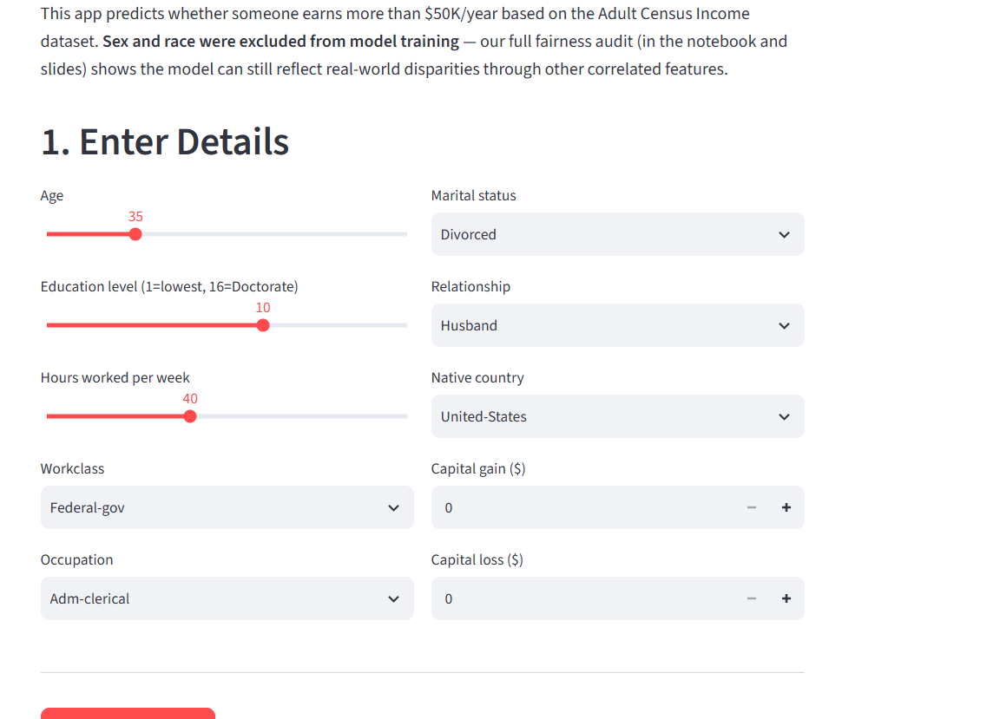
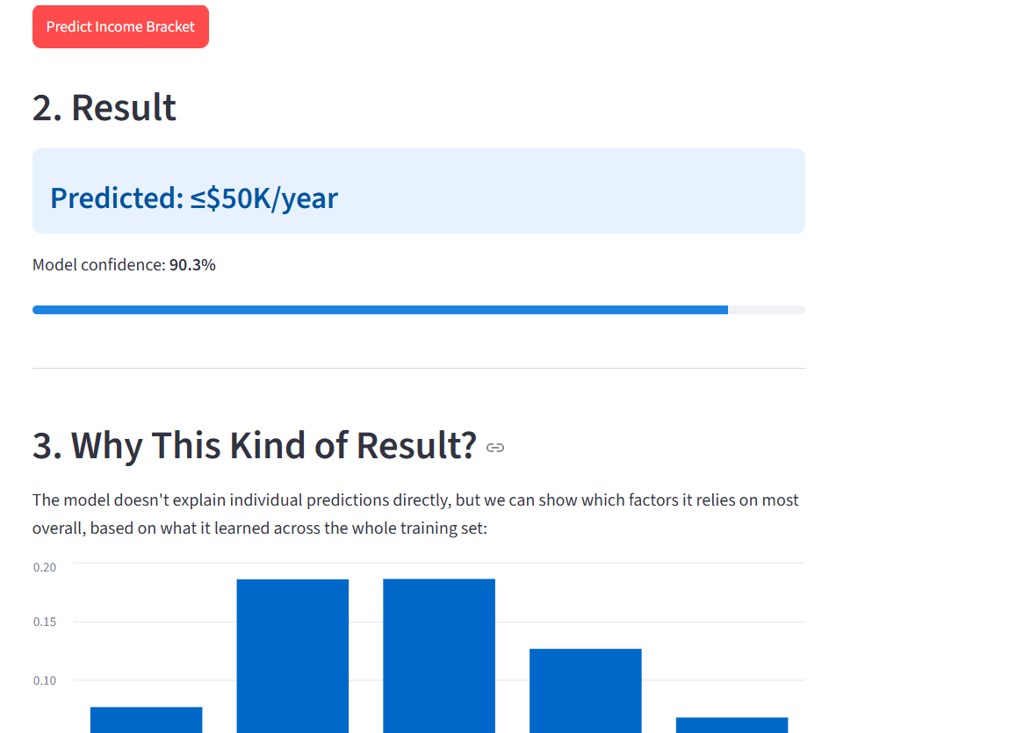
PART B — STEP 4
The Streamlit App
A user enters a hypothetical person's details and receives a live income prediction with a confidence score, plus a plain-language reason behind it.
INPUT FORM
RESULT + REASONING
📷
📷
[ Screenshot: Enter Details form ]
[ Screenshot: prediction + "Why This Kind of Result?" chart ]

Slide 10
CONCLUSION
Recommendations
Don't deploy on unaudited output
Add group-fairness metrics to evaluation
A model with 86% accuracy can still fail specific groups badly — audit before trusting it in production.
Track demographic parity and false negative rate gaps as standard reporting, not an afterthought.
Consider reweighting or resampling
Treat fairness as a design choice, not a default
Techniques like class reweighting during training could narrow the gap without sacrificing much accuracy.
Excluding sensitive attributes is a start, not a guarantee — it must be paired with active measurement.

